Slide 1
УРОК В 11 КЛАССЕ НА ТЕМУ
« ТЕЛЕФОН ДОВЕРИЯ»
Учитель английского языка
МБОУ СОШ № 3 р.п. Сосновоборск
Кондакова Екатерина Дмитриевна

Slide 3


Slide 4
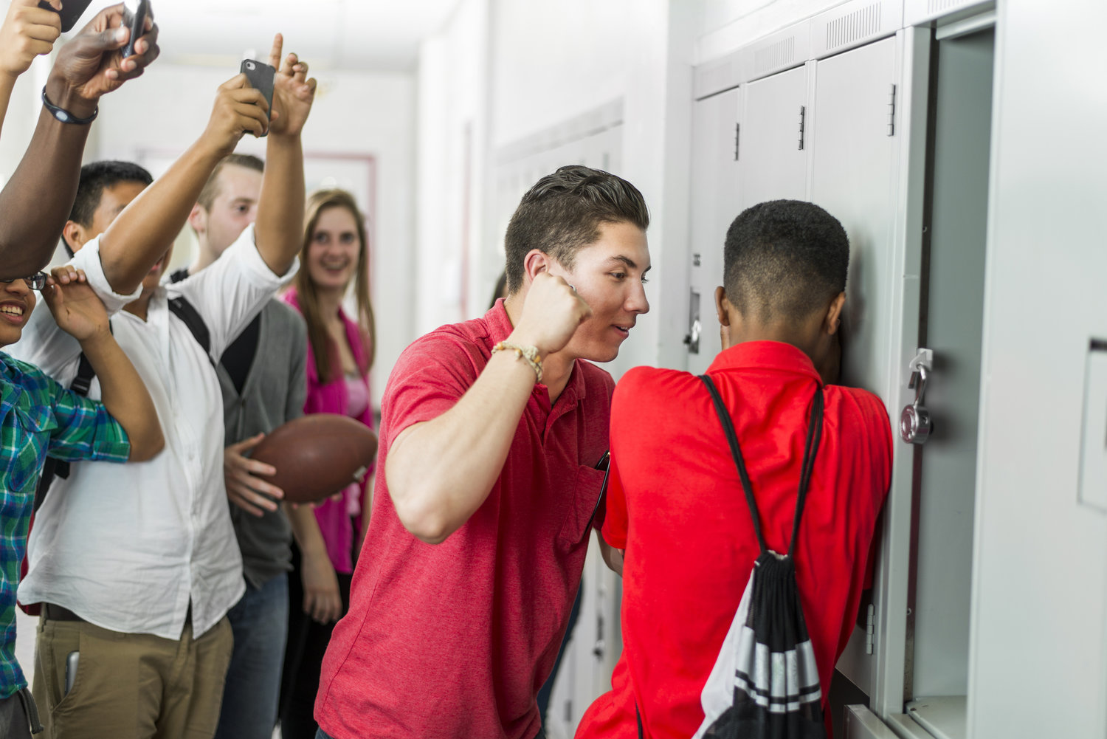

Slide 5
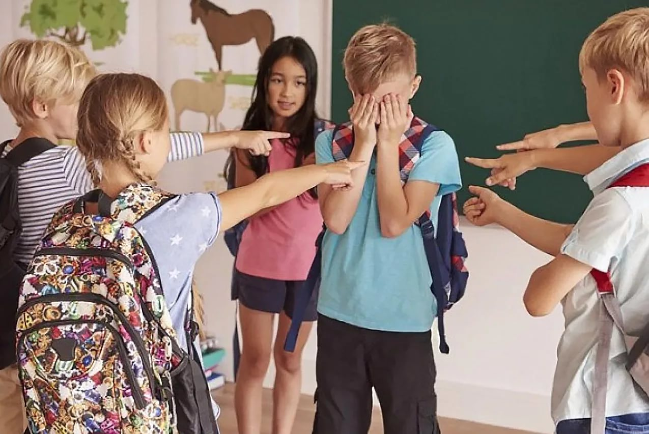

Slide 6
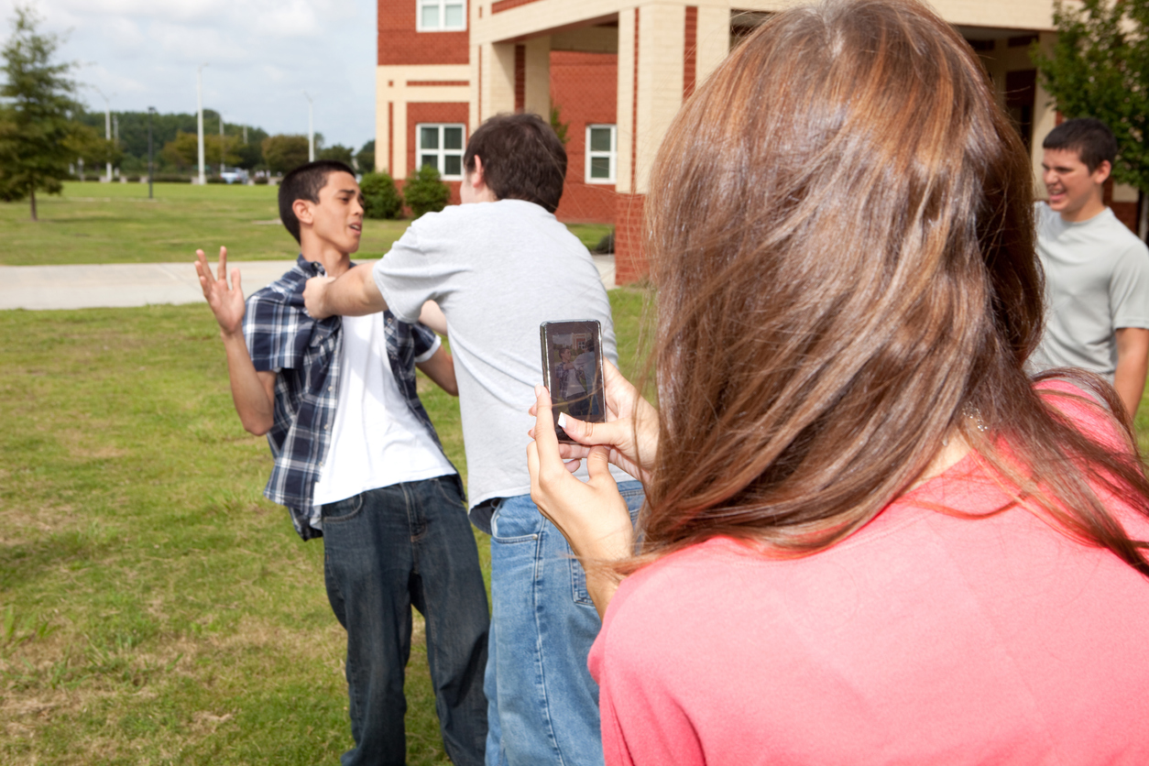

Slide 7
TOPIC OF THE LESSON ?

Slide 8
How can the kids’ problems be solved?

Slide 9
Solution (N)
SOLVE (V)

Slide 11
Counsellor (N)
Council (N) - piece of advice
Counsel (V) - to give someone advice and help with their problems, especially as your job

Slide 12
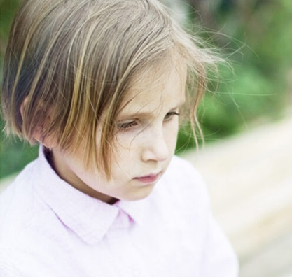
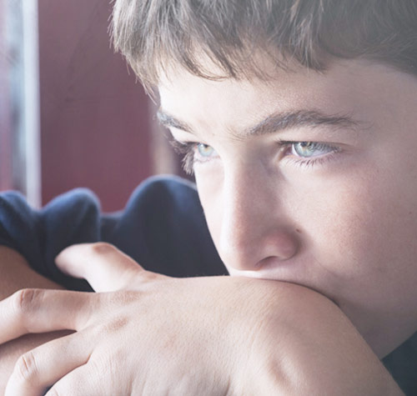



Slide 13
KNOW | WANT to KNOW | LEARNT
 | Who it helps?
 | Location?
 | Working hours?
 | Problems Childline deals with?
 | How counsellors help ?
 | Train volunteer pupils?

Slide 14
Confidence ( N)-
the belief that you are able to do things well
CONFIDENTIAL (Adj) - secret, secretive

Slide 15
SHELTER (N)
- a place where people are protected from bad weather or from danger

Slide 16
HOME (N)
+
LESS (Adj) -
1.( without a place to live)
2. people who are homeless

Slide 17
Wide range of problems
amount/number

Slide 18
WHAT?
LOCATION?
CHILDLINE
WHO ?
Problems to deal with?

Slide 19
Vs
JOIN
CHILDLINE
REJECT

Slide 20
Many people would consider getting involved with Childline

